Slide 1
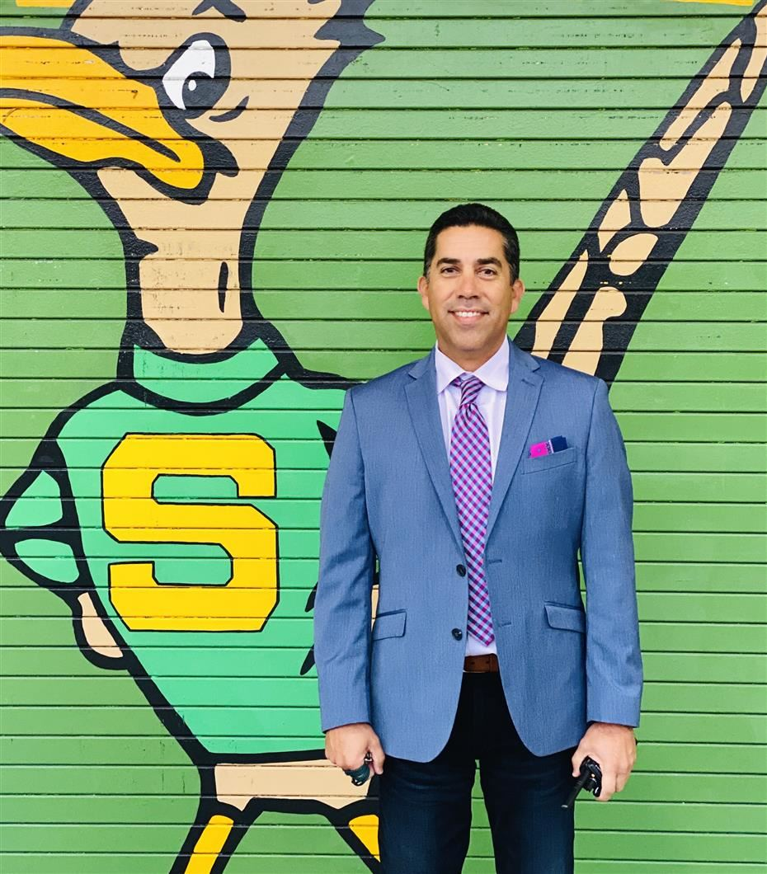
Saddleback Scholars
Wednesday, November 10, 2021
Mr. Bustamante - Principal

Slide 2
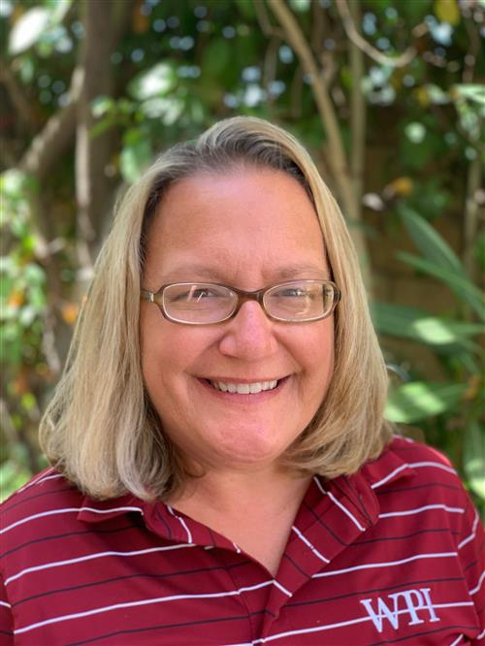
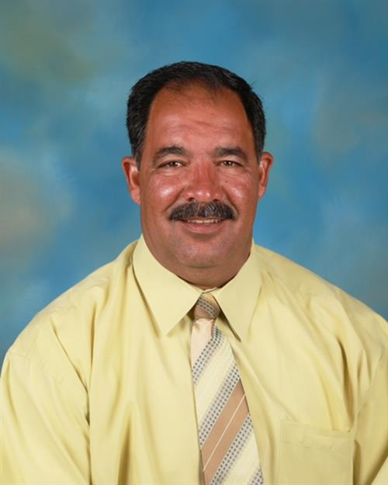
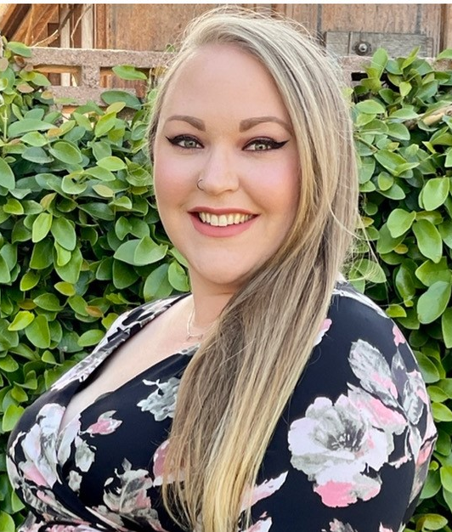
Mrs. Scruton - Assistant Principal
Guidance & Counseling
Mr. Shalash - Assistant Principal
9th & 10th Grade
Dr. Osman - Assistant Principal
11th & 12th Grade
Mrs. LaBare - IB Coordinator
7th & 8th Grade

Slide 3
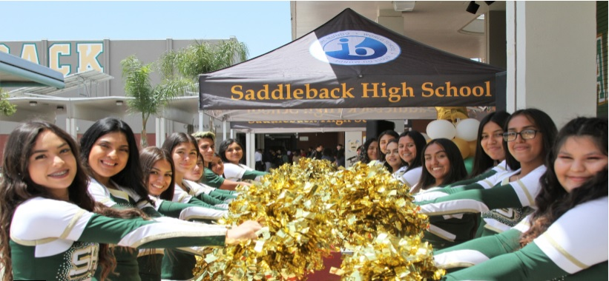
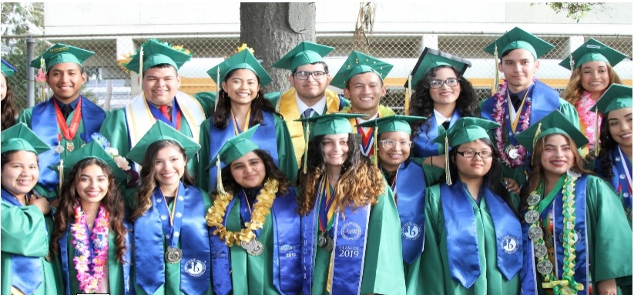
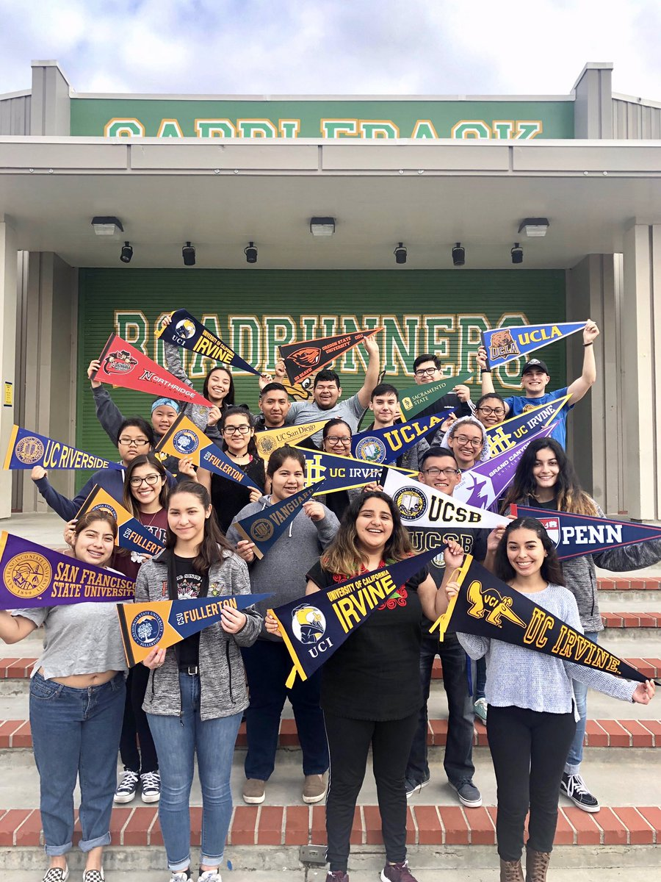
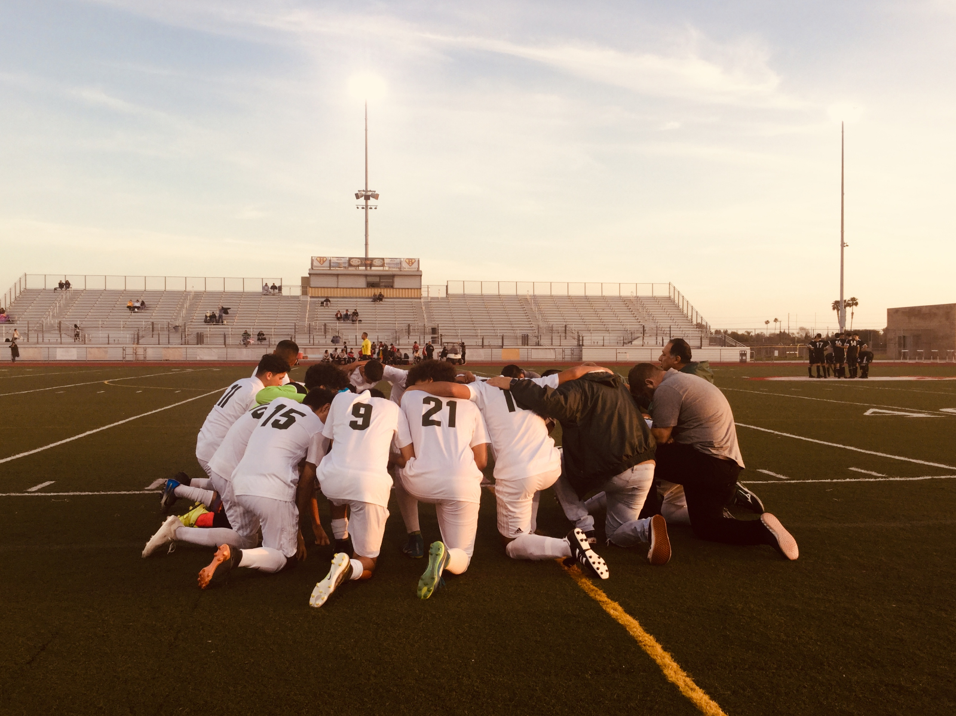
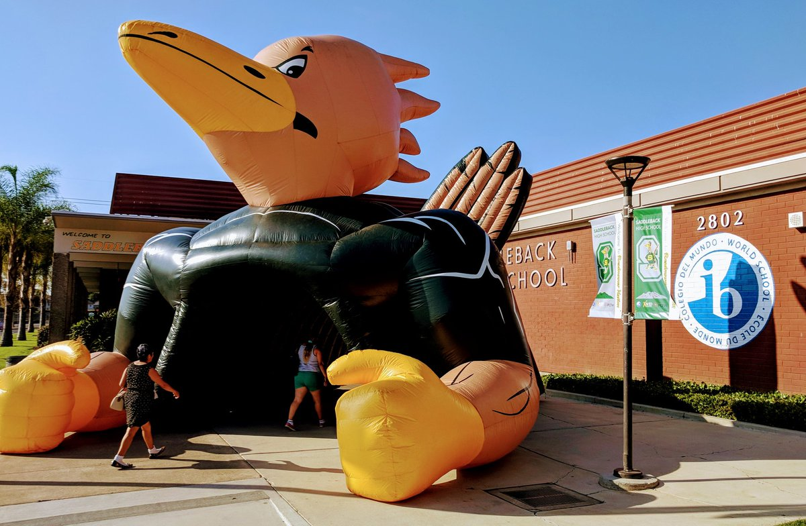
Who Are We?
Saddleback High School - “We will work together to deliver rigorous instruction and personalized support to provide a successful transition to higher education and beyond, while promoting lifelong learning.”
Notes:
Correa

Slide 4
Where are we and what are we doing?
Reflections on the first semester
Is it what you expected?
Goal Setting What’s your plan?

Slide 5
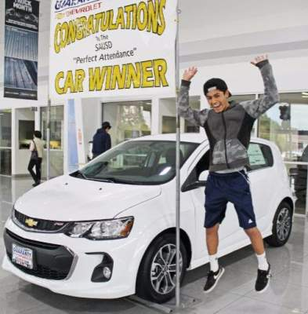
Attendance & Illness
Regular attendance is vital to your success at Saddleback!
Any Absence-Requires a valid reason
Not all absences are excusable
Ilness
Must come to the nurse’s office for evaluation
Don’t call parents ahead of time
Clear Absences-ASAP
Doctor’s Note-Proof
COVID TESTING MONDAYS
Excused vs. Unexcused
Medical-Dental-Illness Court Dates Bereavement School Business | Oversleeping Babysitting Trips outside of the country* Ditching
Student Agenda page 5
Notes:
ADD MONDAY

Slide 6
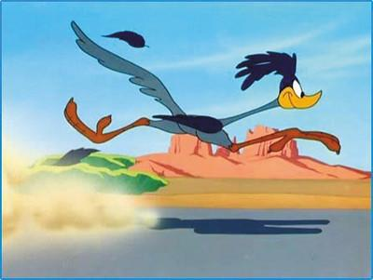
Tardy Policy
Tardy- 1-30 minutes late
Truancy- 31 minutes of more.
An absence will be considered a truancy if not excused
1st Tardy | Warning
2nd Tardy | Parent Contact
3rd Tardy | Parent Contact & Teacher Assigned Consequence
4th Tardy | Teacher Assigned Consequence
5th, 8th, 10th Tardy | Saturday School, SART, or SARB
Student Agenda page 5
Notes:
Correa

Slide 7
Student Conduct
Cell Policy
Headphones/ earbuds
Dress Code
Hoodies
Hats
Skateboards/bikes
Student Agenda page 6-8
Notes:
Correa

Slide 8
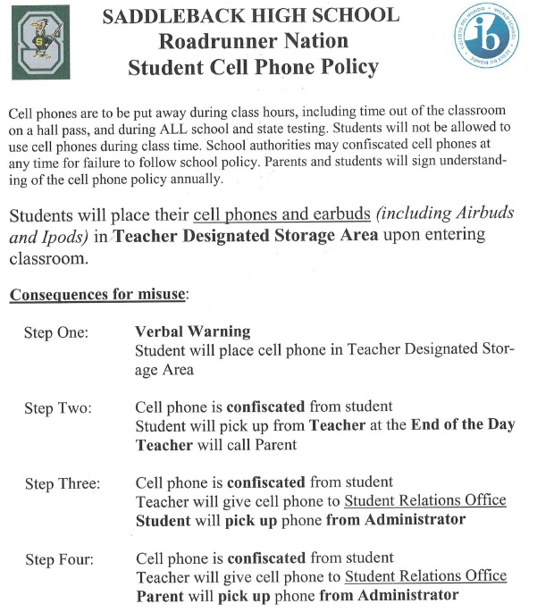
Cell phones
Headphones
Earbuds Policy
*Teacher’s discretion in the classroom
Notes:
Shin

Slide 9
Dress Code - What’s acceptable & What’s not?
Hats / Caps/Beanies
Only Saddleback hats are allowed on campus
Can only be worn outdoor (not in buildings or classrooms)
No Hoodies worn over head except when weather permits (outdoors)
Violation of school dress code can lead to consequences, including parent conference, issuing of spirit wear, detention, campus beautification, Saturday School, or other consequences issued by admin.
Student Agenda page 9
Notes:
Shin

Slide 10
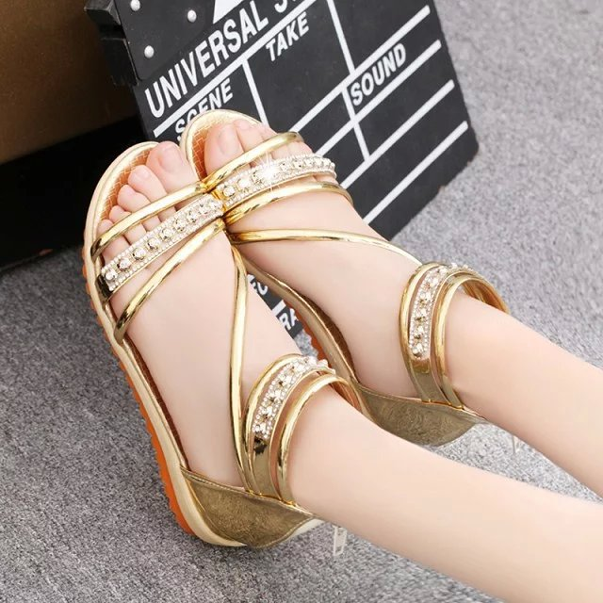
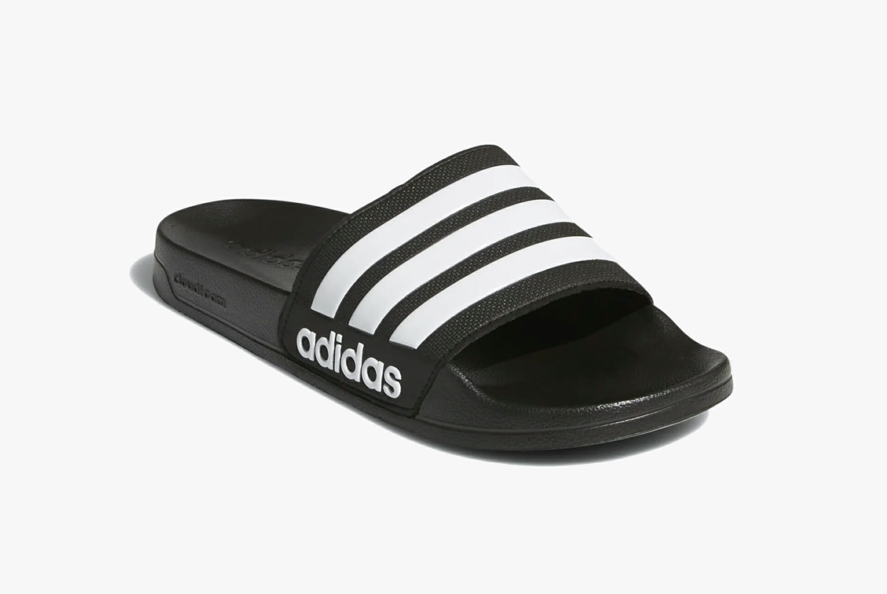
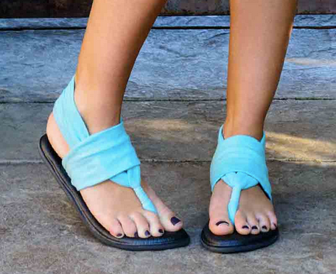
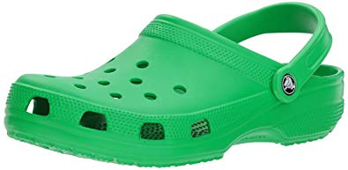
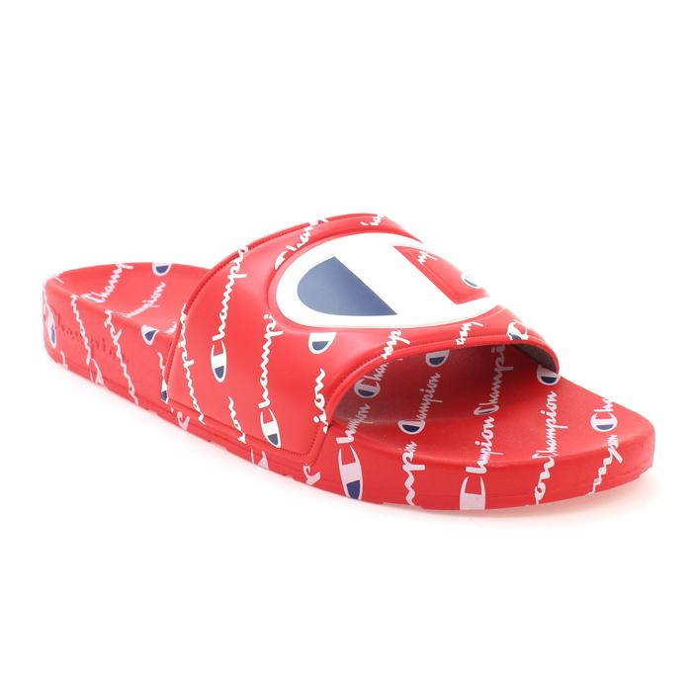
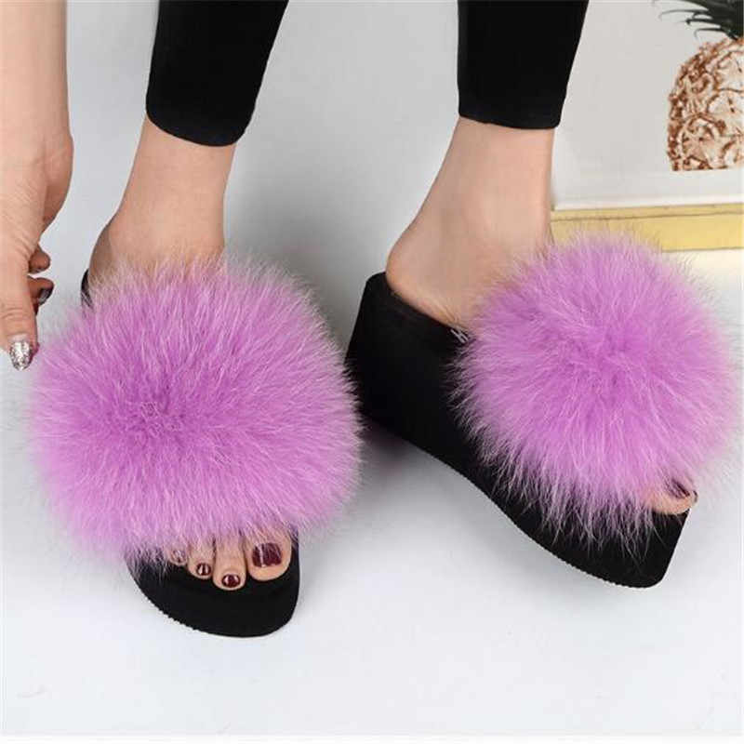
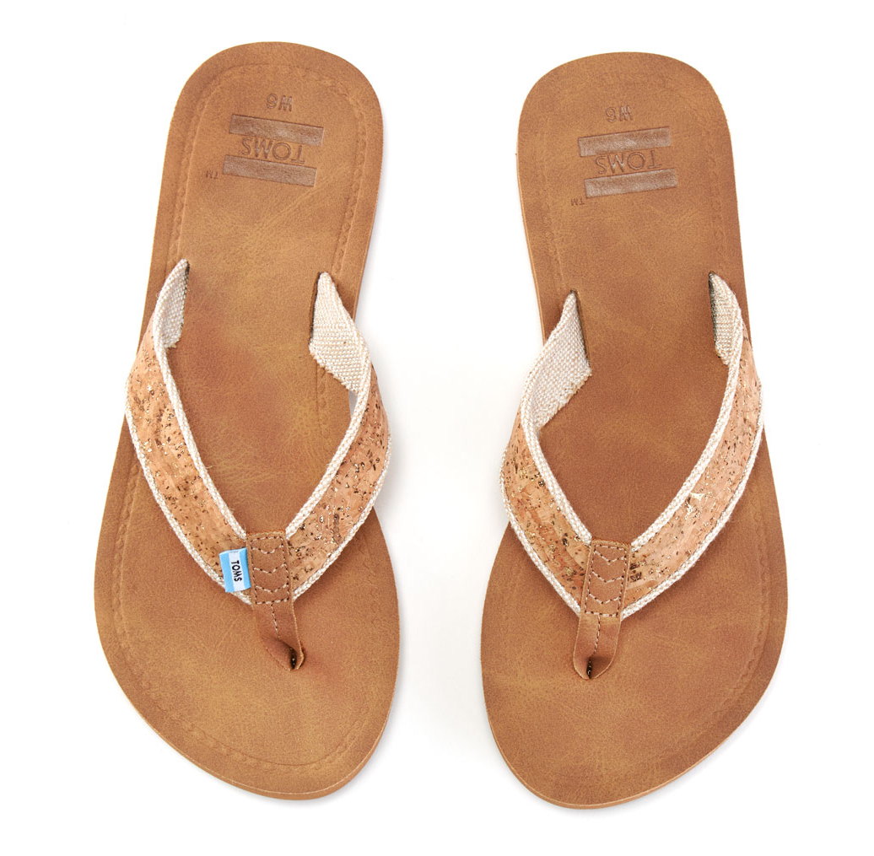
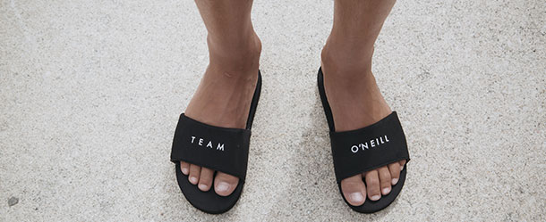
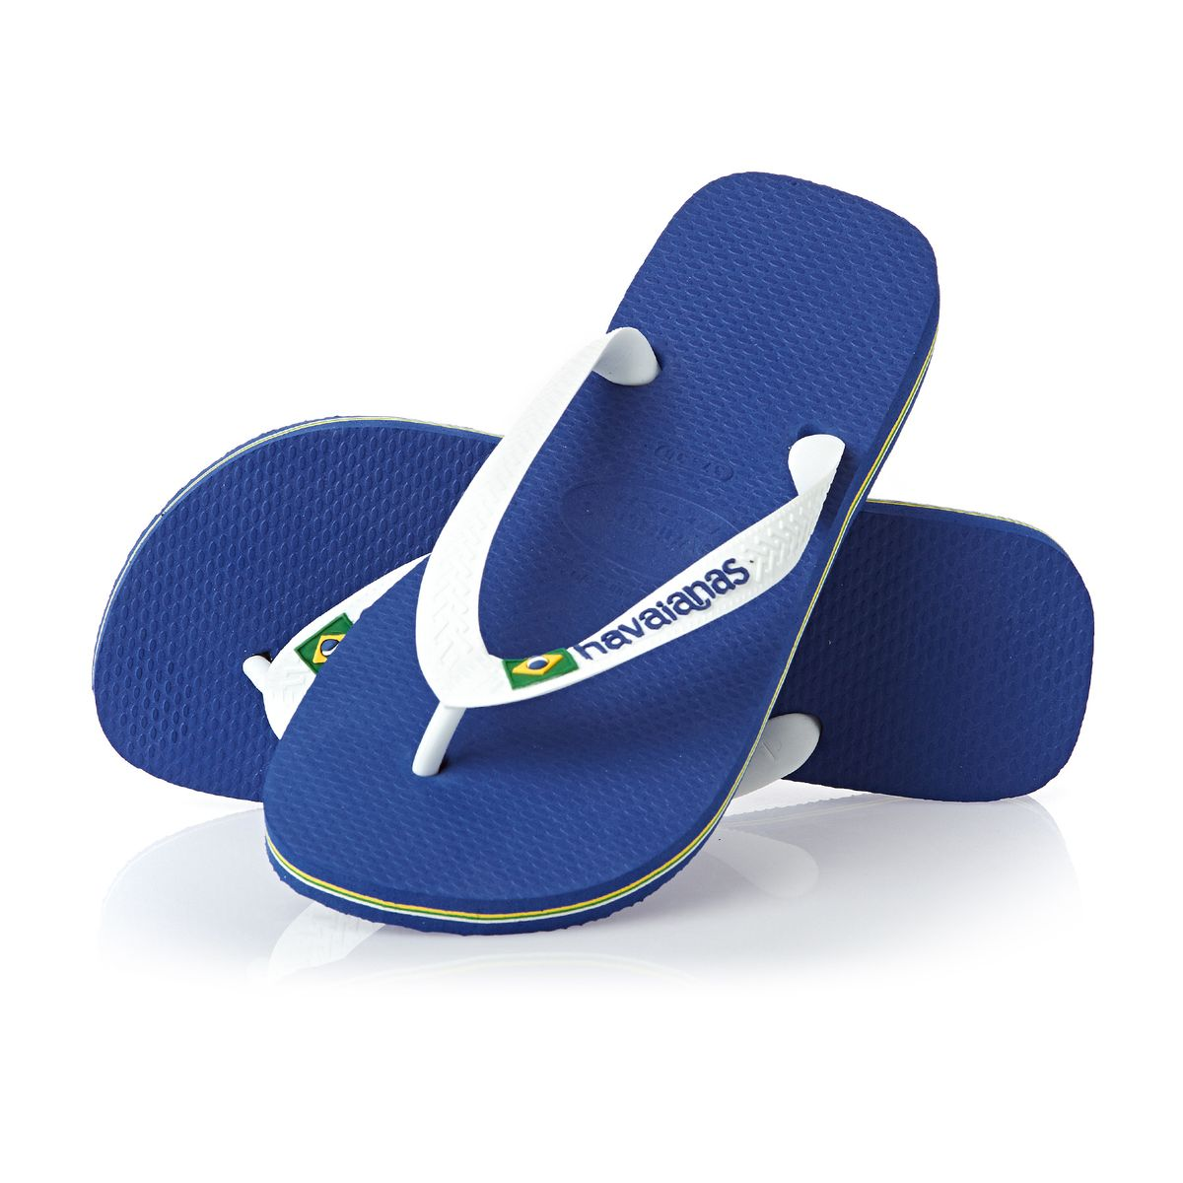
Slides & Sandals - What’s acceptable & What’s not?
Sandals without a strap are not allowed
Student Agenda page 9
Notes:
Shin
Safety First - Some facial rings can be unsafe for students. When in doubt, check with Discipline Office

Slide 11
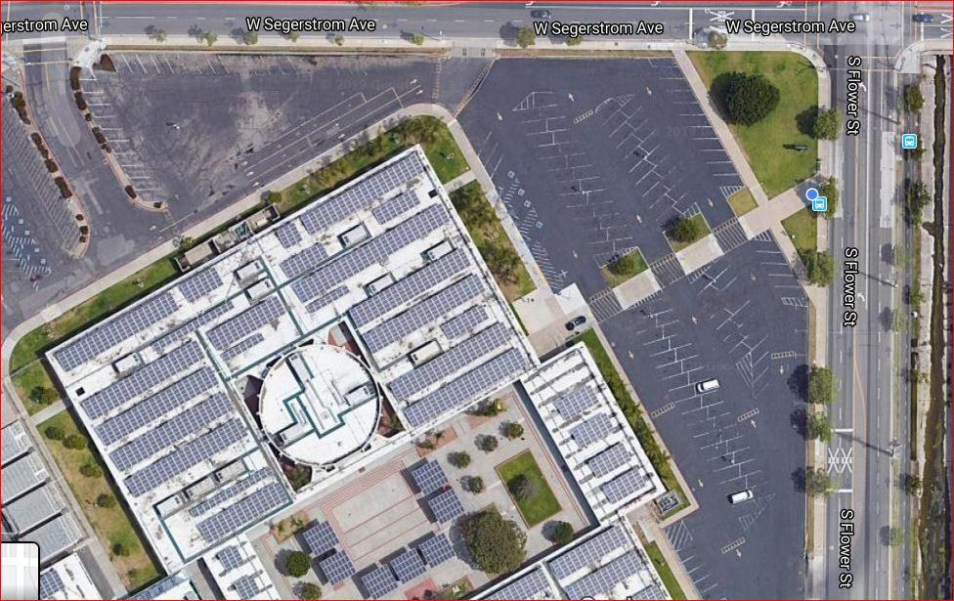
Skateboards & Bicycles
No riding on the skateboards or bicycles on campus or inner perimeter of campus
You are responsible for your own belongings
Notes:
Shin

Slide 12
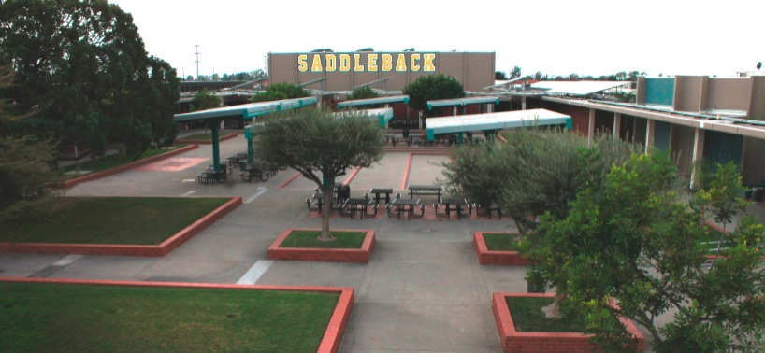
Lunch
Attend your assigned lunch
No outside foods are allowed during lunch
No deliveries accepted
Please make sure to clean up after yourself!
Clear your tables after breakfast and lunch!
Notes:
Shin

Slide 13
Grading Policy
SCALE | LETTER GRADE
90-100 | A
80-89 | B
70-79 | C
60-69 | D
50-59 | F
Grade | 1st Semester | 2nd Semester
7th | 30 | 60
8th | 30 | 60
9th | 30 | 60
10th | 90 | 120
11th | 150 | 190
12th | 210
Notes:
ADD 7TH/8TH

Slide 14
Chromebooks
Bring your Chromebook to school charged!
Bring broken devices to the library.
Use a case!
Buy insurance to cover repair costs.
Check out loaner chromebooks before school if yours is out for repair
Do not loan it to friends.
Do not leave it in your teacher’s classroom.
Notes:
Gerdes

Slide 15
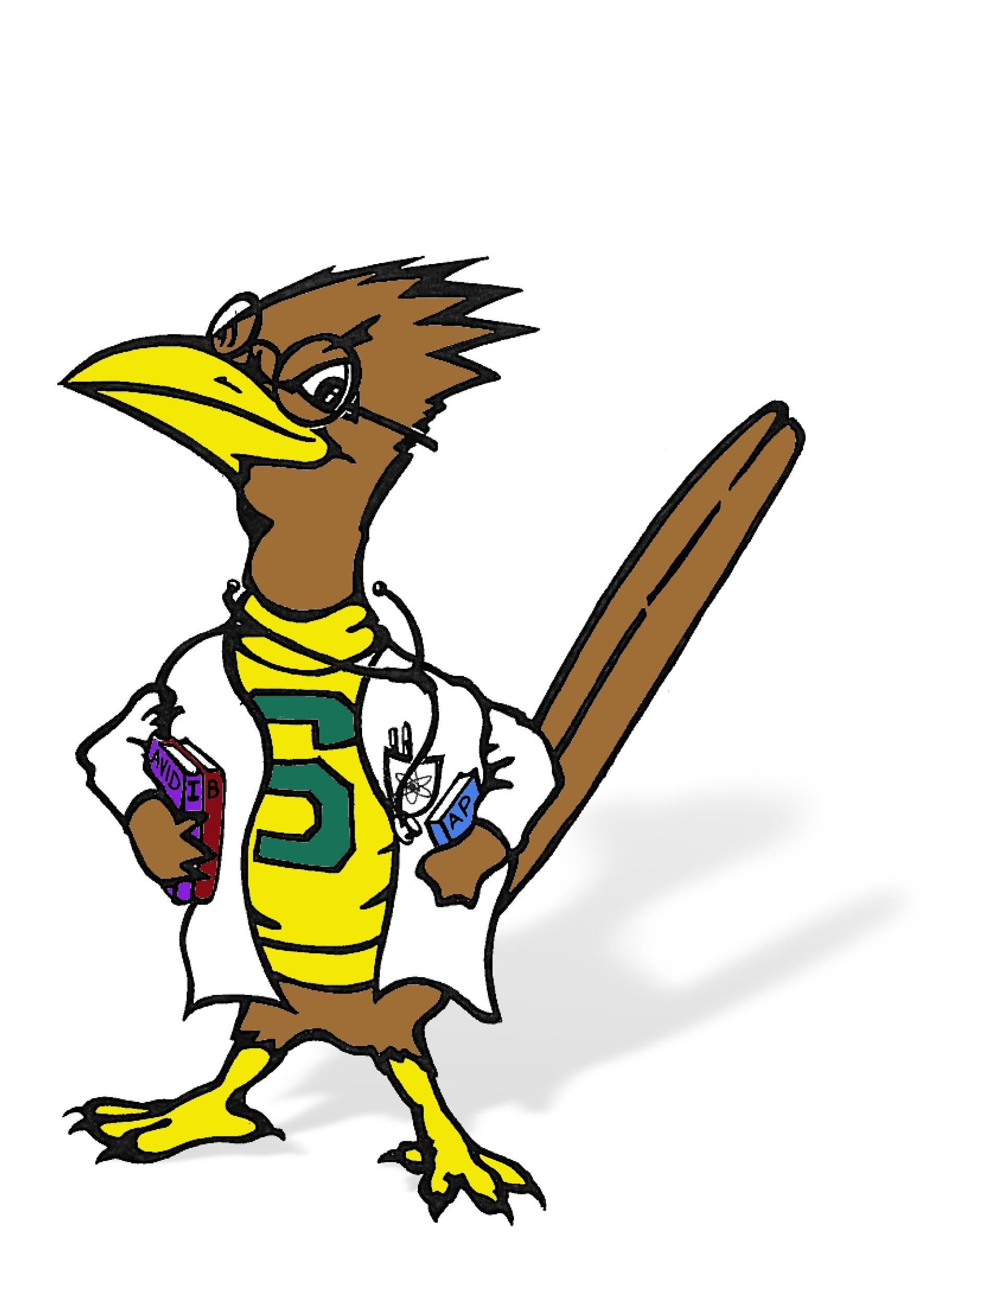
Spring Testing
Month | Test | Date | Who takes it?
February | ELPAC | throughout | EL Students, grades 9-12
March | MAP Reading/Math | 3/21-4/22 | 9th & 10th grade ELA/Math students
April | CAASPP | throughout | 11th graders in ELA, Math, & Science
May | AP Exams IB Exams Senior Finals | throughout | AP Students (Grades 10-12) IB Students (Grades 11-12) 12th grade students
Notes:
Correa

Slide 16
Spring Activities
Month
January | Spring dance
February | End of 6 Week grades Class Registration
March | Talent Show Spring Sports 8th Grade Visitation Open House
April | Spring Break Prom 12 Week grades
May | AP/IB Testing Graduation
Notes:
Correa

Slide 17
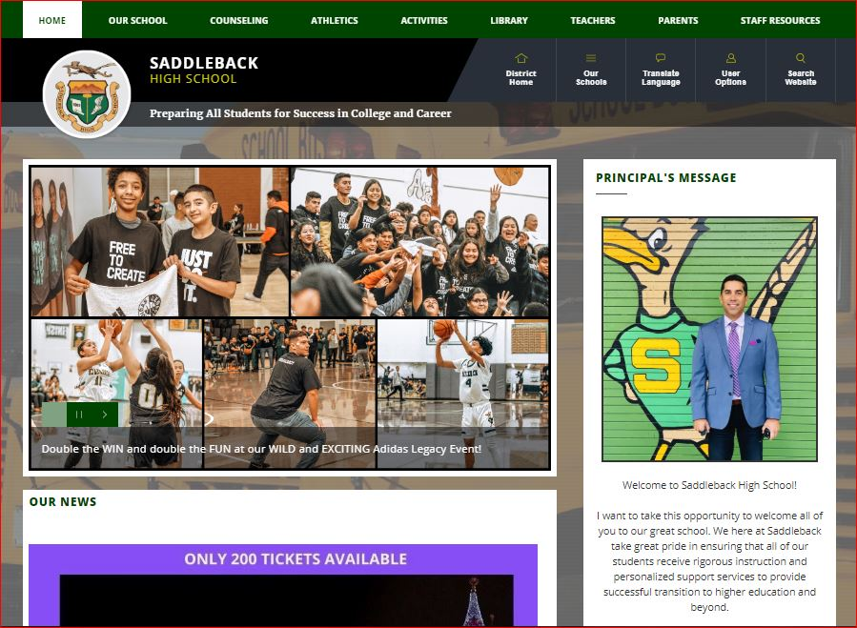
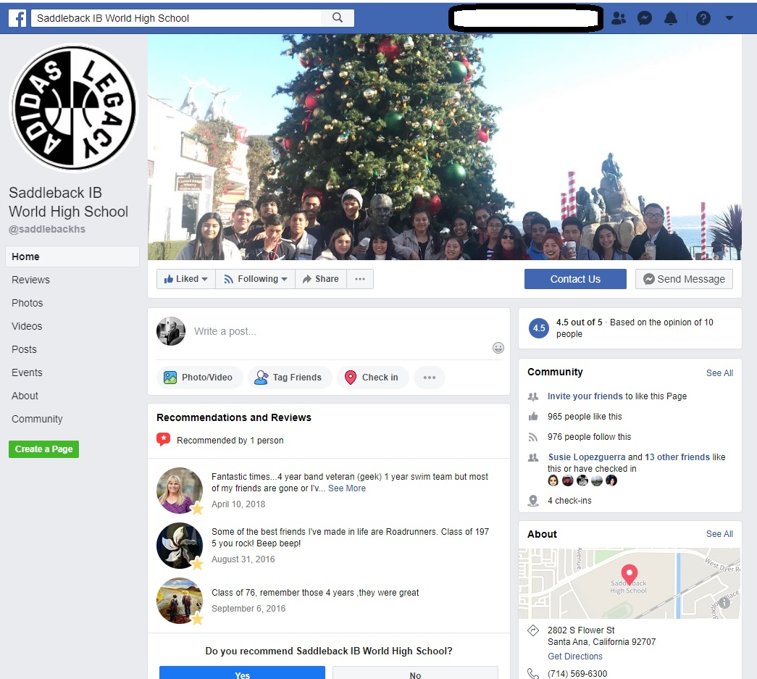
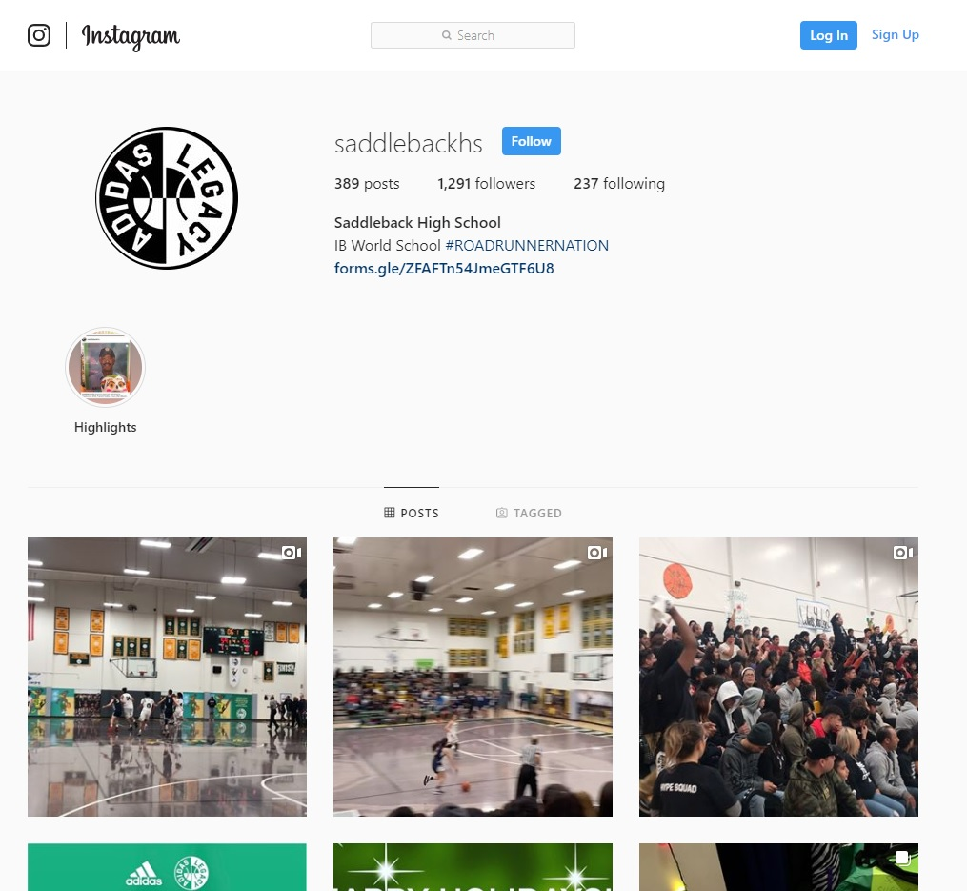
Connect with Saddleback
@saddebackhigh
Notes:
Gerdes

Slide 18
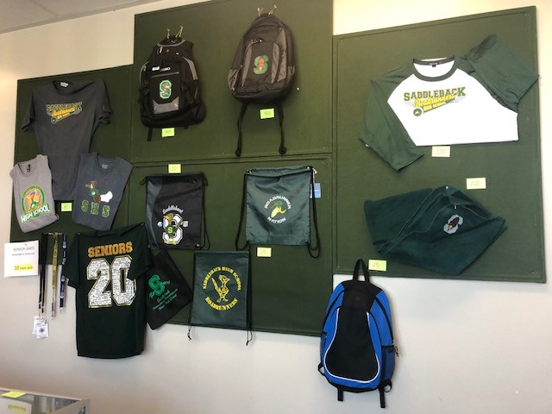
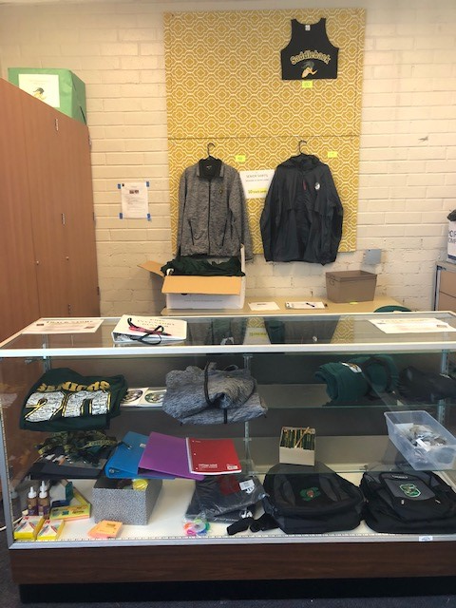
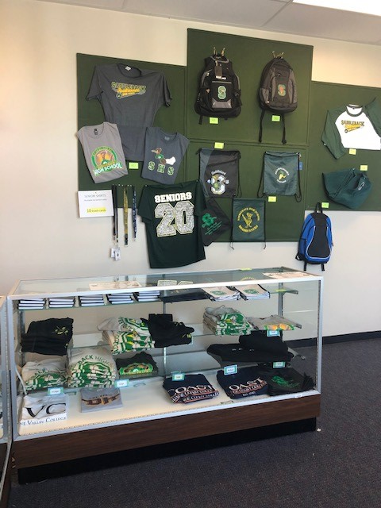
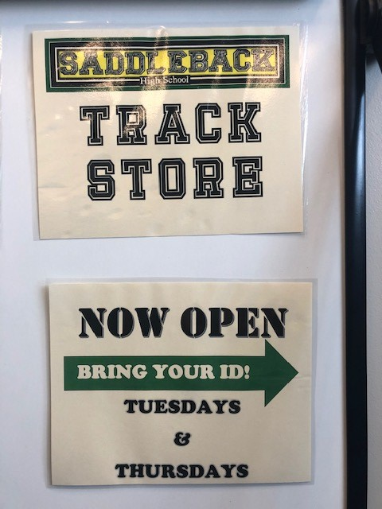
School-Wide Expectations
Practice TRACK
Earn a TRACK reward card
Redeem for prizes
Notes:
Shin

Slide 19
Words of Wisdom to our Roadrunners
Pass all your classes with a “C” or better
Use your Student Agenda
Check Student Portal daily
Get help!
Join a club!
Plagiarism is NOT okay
Use your resources
Teachers
Counselors
Free tutoring
Clubs
Sports
Notes:
Correa

Slide 20
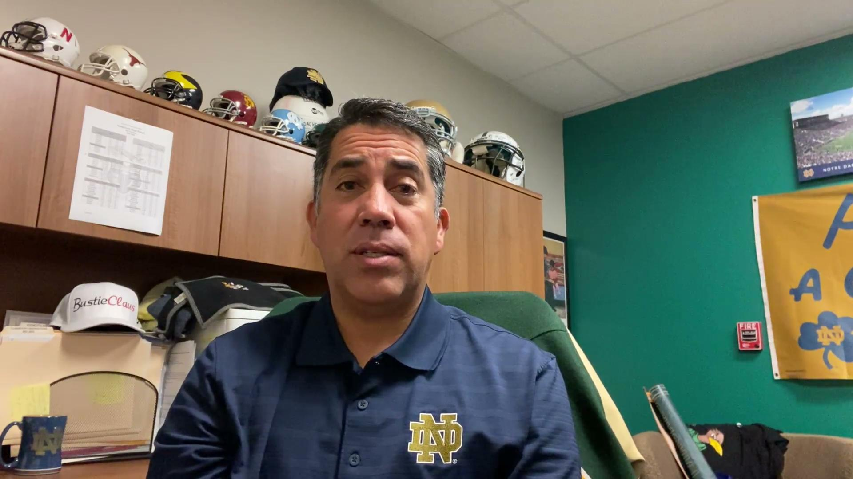
BustieClaus
Notes:
Correa

